Slide 1
Star Track
Satellite Navigation with Machine Learning
Jacob Heglund
Engineering Physics - Undergraduate
jheglun2@Illinois.edu

Slide 2
Problem Motivation
Extremely accurate and consistent for “lost in space” problem
Inexpensive star tracking systems at least $100,000
Limited modern research in ML applications to star tracking (Hong et. al. 2000, Trask 2002, Li et. al. 2003)

Slide 3
Problem Formulation
Questions to answer
1. Can we find a satellite’s rotational rate from consecutive images taken by a star tracker?
2. Can we find a satellite’s instantaneous attitude from consecutive images taken by a star tracker?
Star Tracker – a camera attached to a satellite, takes images at ~3 FPS
Instantaneous attitude – rotational position at a snapshot in time

Slide 4
Problem Formulation
Problem Setup – Satellite “wakes up” with no information about its attitude or rate (may be rotating in general)
Autonomy Goal – As satellite takes image data, want the internal representation of attitude and rate to converge to within some error of actual attitude and rate in a specified amount of time
Autonomy Implementation – Since the incoming image data varies in time, we choose to use an LSTM framework

Slide 5
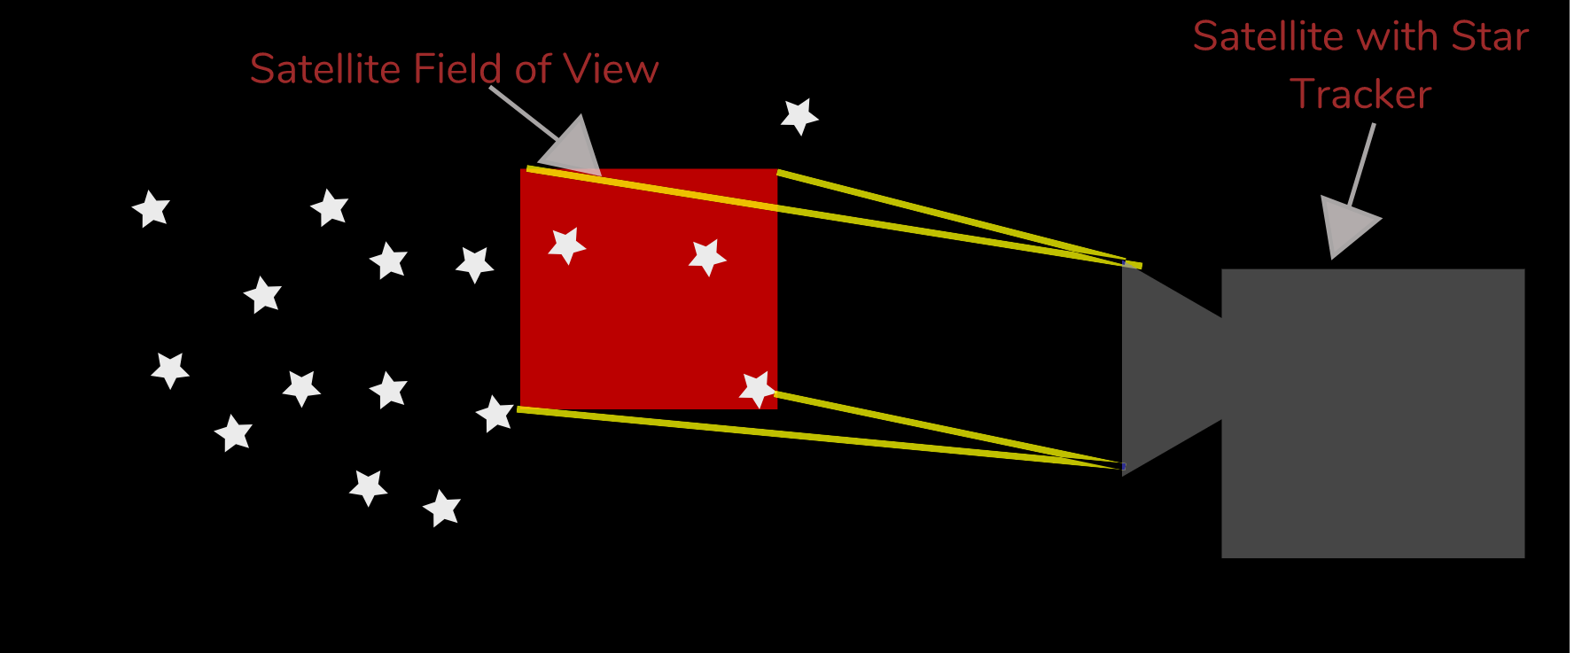
Problem Formulation

Slide 6

Results
Developed a simulation that uses a very high quality image of the celestial sphere to generate realistic satellite FOV for a rotating satellite
Below is a sample of the data taken by the Tycho mission used in this project

Slide 7
Results – Simulation Output
Below is an example of the output of the simulation, the entire image is 16384 x 8192 pixels and is a high quality, 360° spherical view of the sky
The white space below represents the unseen parts of the sky
The black square is the satellite’s FOV (~ 900x900 pixels)
t = 0 seconds
t = 5 seconds
t = 10 seconds

Slide 8
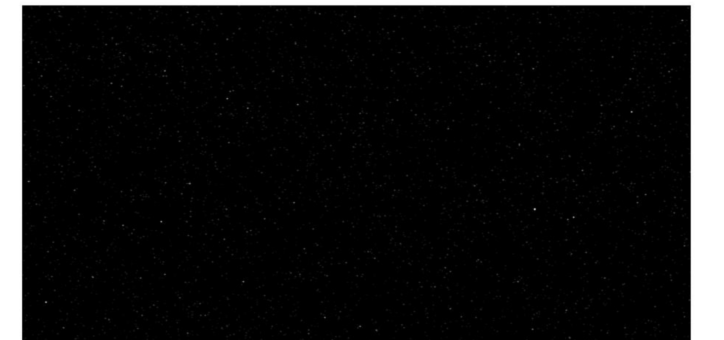
Results – Simulation Output
Blowing up the image from the simulation output, we clearly see a unique configuration of stars for the star tracking to learn and associate with this sector of the sky

Slide 9
Work for Final Report
Generate training data from initial positions and velocities
A single set of training data will be several images as seen by the star tracker presented in a time-series that sweeps out a swath of sky
This image will be converted to a tensor containing 2 dimensions of pixel position information and 1 dimension of black / white color information
Train LSTM in TensorFlow / Keras
Input to the network will be image tensors presented at each timestep of the simulation
Get preliminary results showing feasibility of LSTM as a method of star tracking

Slide 10
Future Work
Show pointing accuracy with this star tracking as the only sensor input
Show robustness to low quality images from star tracker
Could use lower quality lenses to reduce the overall price of the star tracker system
Perform real-time simulation of the satellite and network

Slide 11
Questions?

Slide 12
References
Li, C., Li, K., Zhang, L., Jin, S., & Zu, J. (2003). Star pattern recognition method based on neural network. Chinese Science Bulletin, 48(18), 1927-1930.
Hong, J., & Dickerson, J. A. (2000). Neural-network-based autonomous star identification algorithm. Journal of Guidance, Control, and Dynamics, 23(4), 728-735.
Trask, A. J. (2002). Autonomous artificial neural network star tracker for spacecraft attitude determination (Doctoral dissertation).
Ho, K. (2012). A survey of algorithms for star identification with low-cost star trackers. Acta Astronautica, 73, 156-163.
Spratling, B. B., & Mortari, D. (2009). A survey on star identification algorithms. Algorithms, 2(1), 93-107.
Krizhevsky, A., Sutskever, I., & Hinton, G. E. (2012). Imagenet classification with deep convolutional neural networks. In Advances in neural information processing systems (pp. 1097-1105).
Hochreiter, S. (1998). The vanishing gradient problem during learning recurrent neural nets and problem solutions. International Journal of Uncertainty, Fuzziness and Knowledge-Based Systems, 6(02), 107-116.

